Slide 1

Tech Layoff
Created by : Yash Gode
Dataset Link : Tech Layoff 2022

Slide 2
Project Description
Big companies and organizations are facing problems and many of them are laying off their employees in response to that. There are multiple reasons, varying from company to company.
This Dataset Consists of list of top companies that have laid off their employees in 2022.

Slide 3
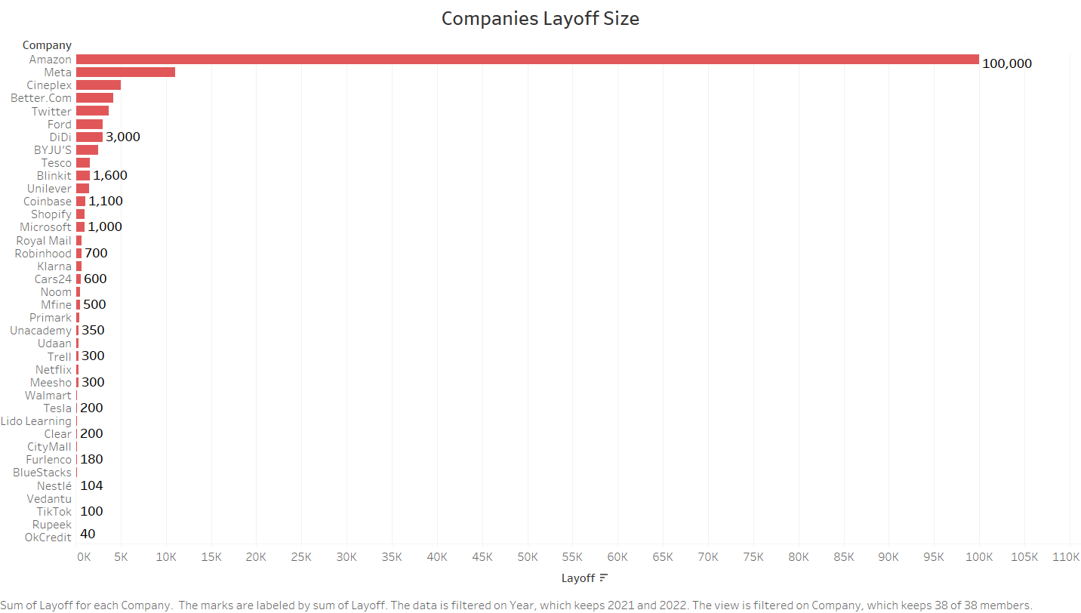

Slide 4
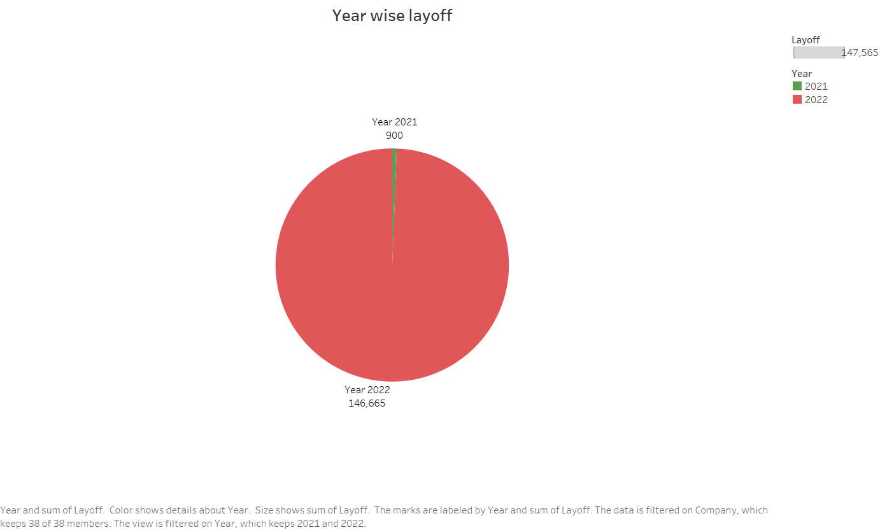

Slide 5
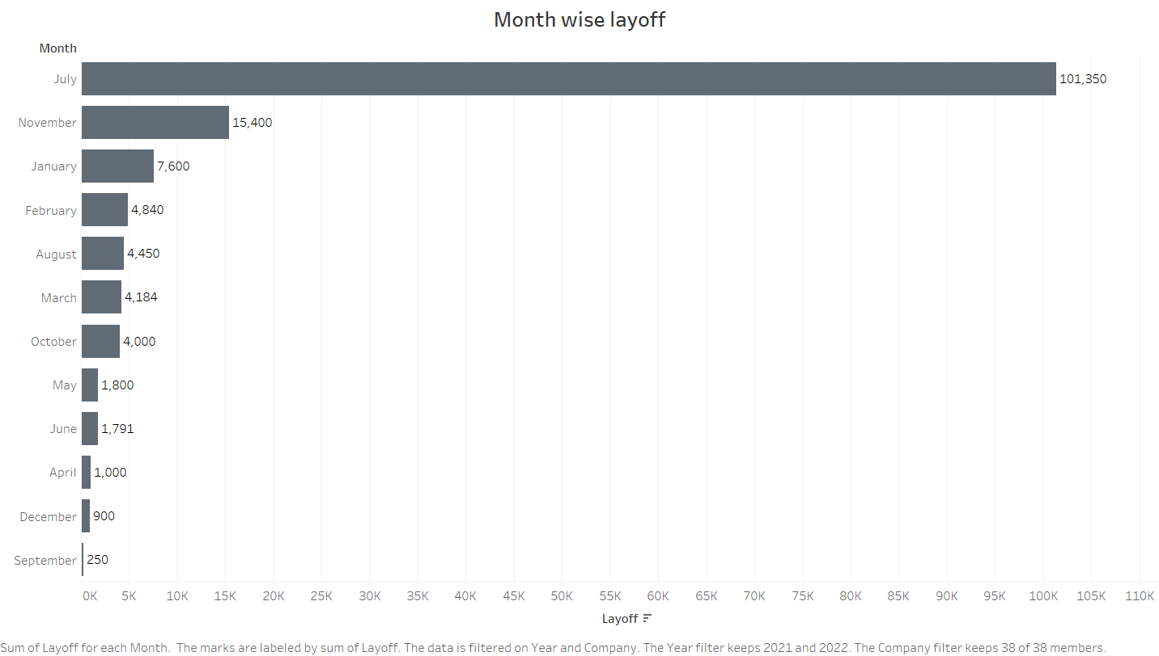

Slide 6
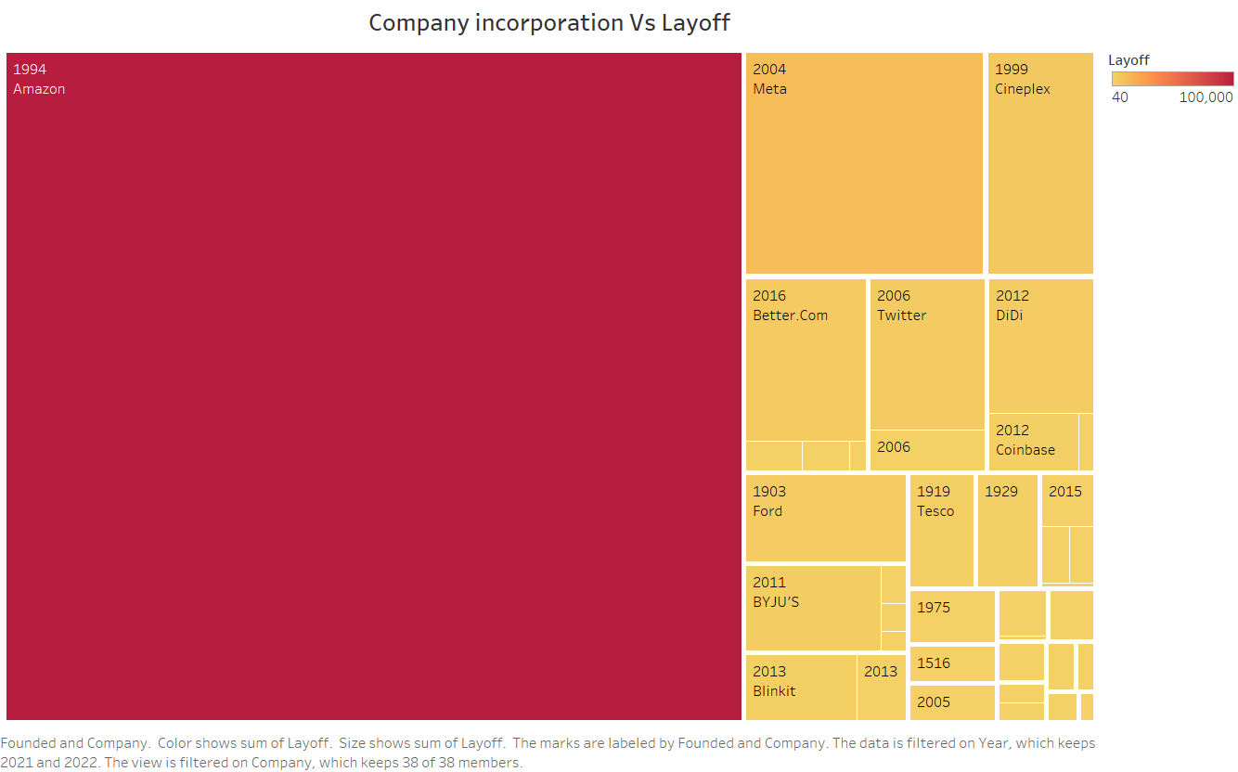

Slide 7
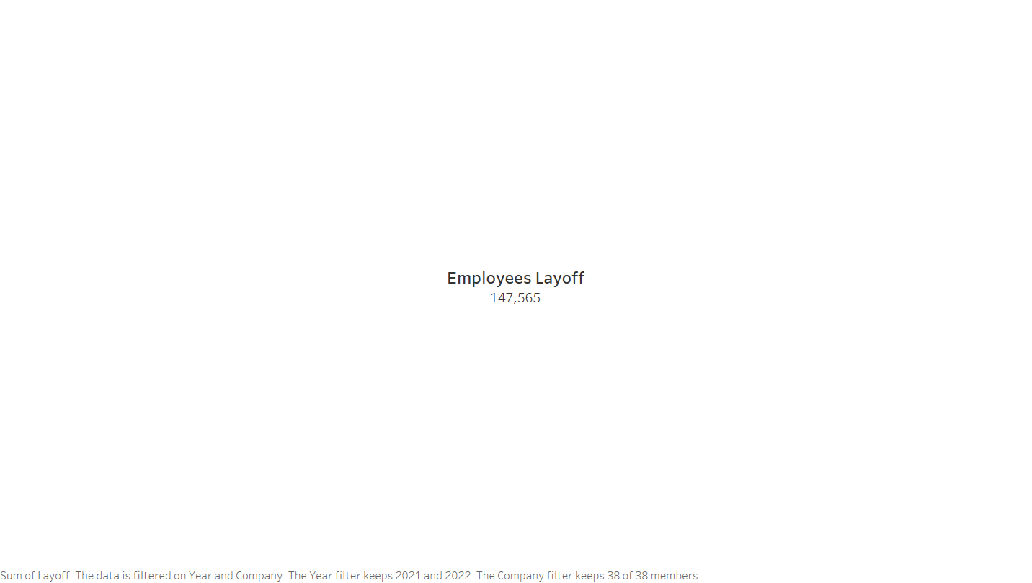

Slide 8
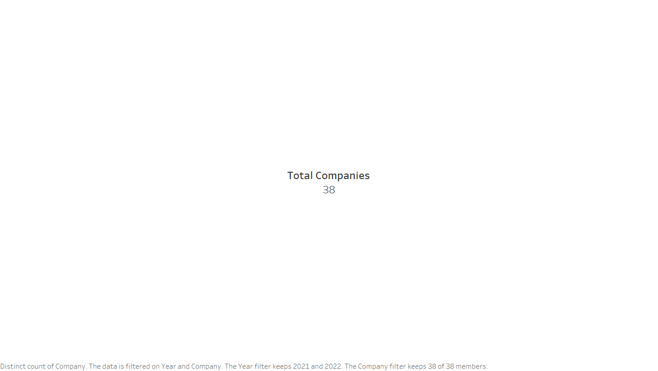

Slide 9
